Slide 1

Coupled Groundwater/Surface-Water Modeling using GSFLOW ID2447 December 3-6, 2018 USGS New Mexico Water Science Center

Slide 2

Thanks to our hosts, Andrew Robertson and the New Mexico water science center

Slide 3
Instructors Ayman Alzraiee, California water science center Murphy Gardner, Nevada water science center Steve Markstrom, Water mission area, Colorado Rich Niswonger, Water mission area, California Steve Regan, water mission area, Colorado

Slide 4
Course objectives
Provide purpose, capabilities, and theory for GSFLOW
Present conceptual approach for building GSFLOW model
Provide demonstration of tools (GUIs, Python) for building models
Use demonstrations and exercises to illustrate methods, tools, work flow (Jupyter Notebooks, ArcMap, PRMS GUI)
Progress on individual WSC GSFLOW applications through class project
Participants leave class with work flow and tools for building GSFLOW model from the ground floor

Slide 5
Class agenda at Thirty thousand feet
Day 1: PRMS, MODFLOW, GSFLOW overview (PowerPoint)
Day 2: Building models, developing workflow (GSFLOW-Arcpy, Gsflowpy, Notebooks)
Day 3: Calibration (Gsflowpy, PowerPoint, Notebooks)
Day 4: Class project

Slide 6

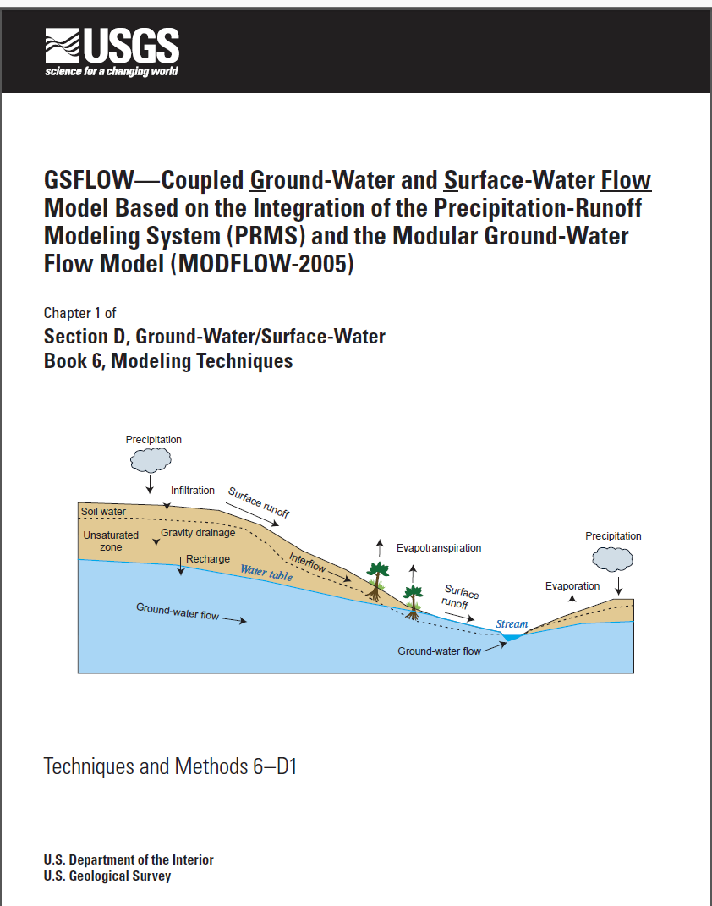
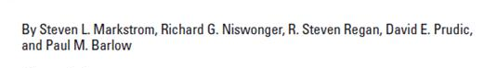
GSFLOW
Integrated hydrologic model
Supply limited and demand driven water use
Regional scale water resources analysis

Slide 7
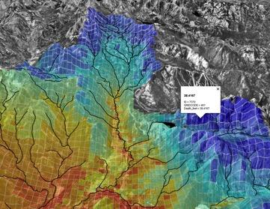
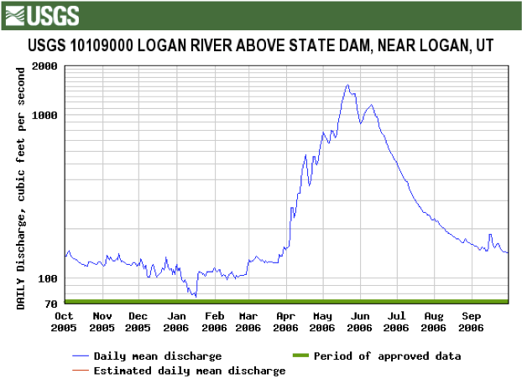
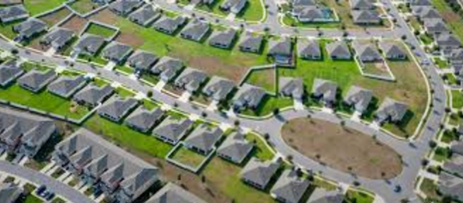
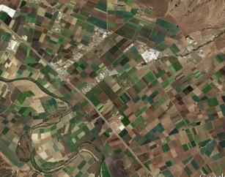
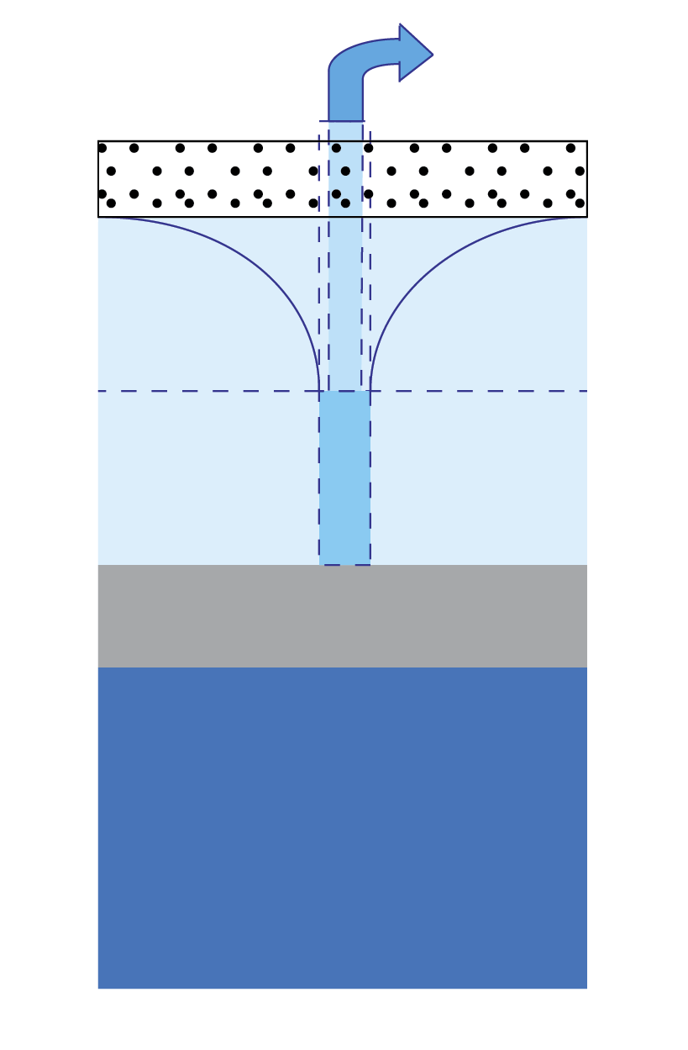
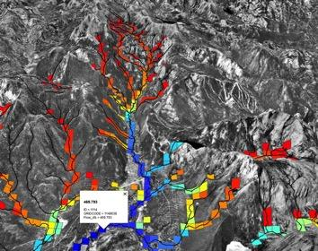
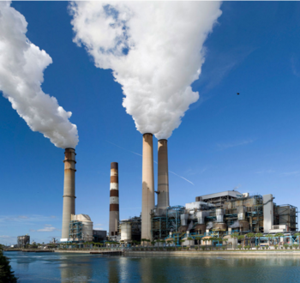
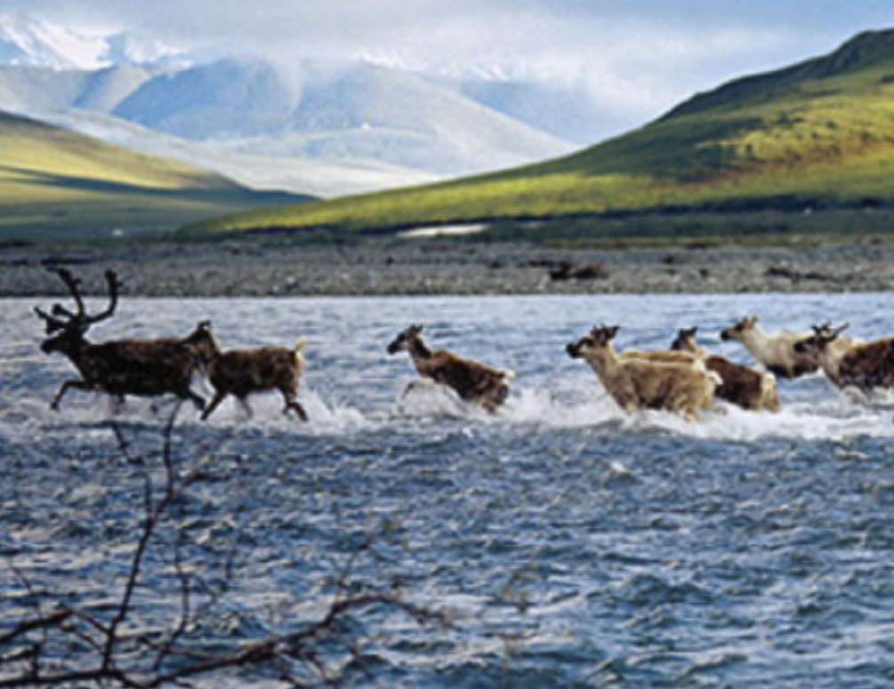
Decision support tools for Hydrology
Surface water
Snowpack, rain, river, and groundwater storage forecast
Runoff to rivers
Water for municipalities, agriculture, industry, and wildlife
Groundwater

Slide 8

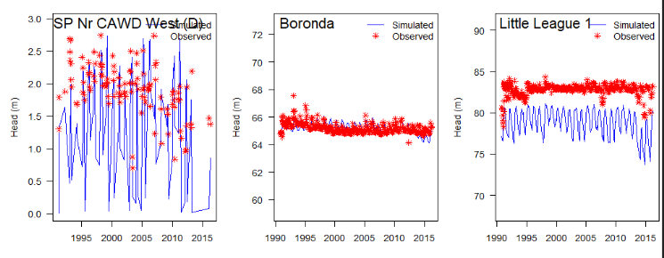
What is an integrated model?
River flow
GW heads

Slide 9
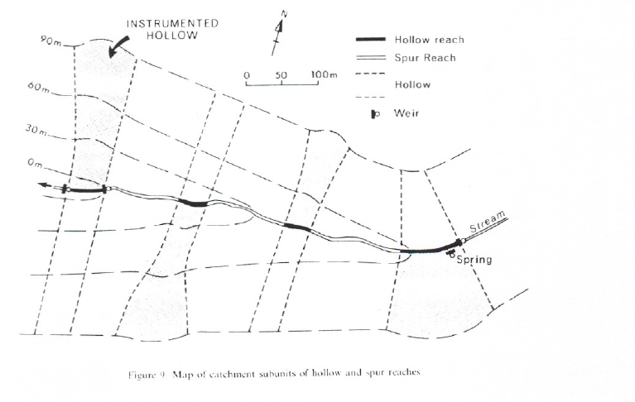
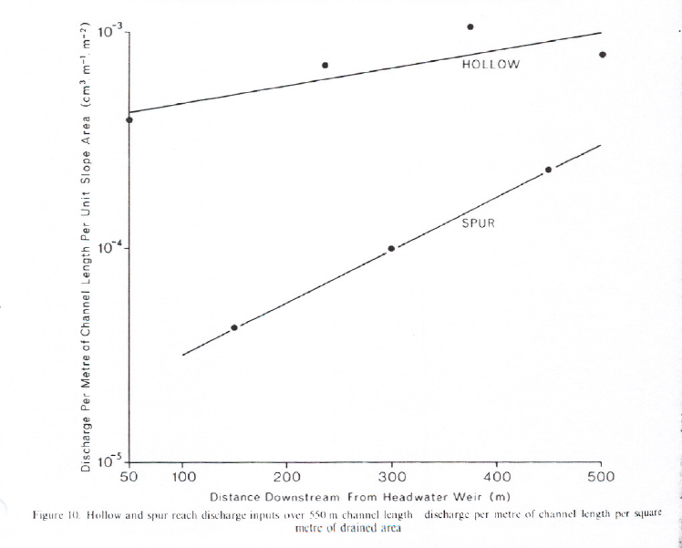
Shallow lateral flow
Anderson and Burt, 1978
Converging (“hollow”) verses diverging (“Spur”) flow
hollow
spur

Slide 10
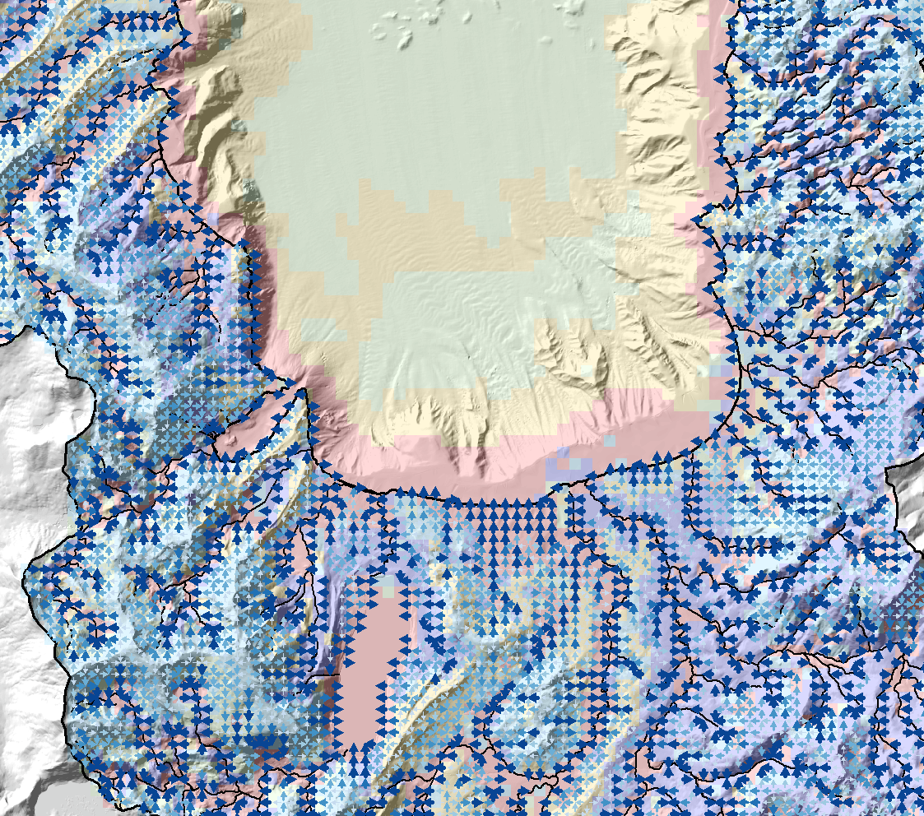
cascades
Lateral flows routed according to topography and topology
Cascades determined using Cascade Routing Tool (Henson and others, 2013)

Slide 11
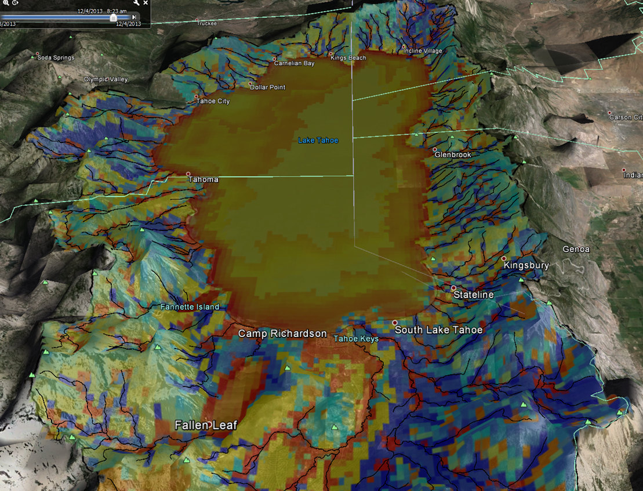
Simulated recharge/discharge
Red-GW discharge
Blue-GW recharge
Gold-Zero

Slide 12
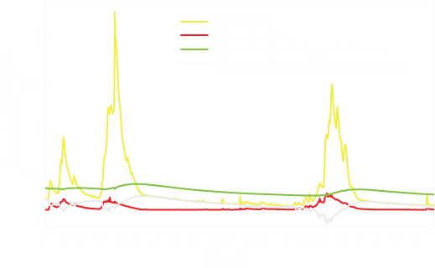
Huntington and Niswonger, 2012

